Slide 1
Governance and Compliance
GRC Day 3

Slide 2
Class Objectives
By the end of today’s class, you will be able to:
Explain how organizations use policy and procedure to formalize standards of “right” and “wrong.”
Use governance frameworks to determine which policies an organization must develop.
Explain how business continuity planning and disaster recovery ensure business and mission critical functions in the event of a disruption.

Slide 3
Structure of the security organization and the importance of security culture.
Threat modeling and risk analysis.
Day 1
Day 2
Today
We will cover governance, compliance, and business continuity planning and disaster recovery (BCP and DR).

Slide 4
Governance: codifying and enforcing proper behavior and operations by establishing standards of “right” and “wrong”.

Slide 5
Compliance: enforcing the policies in order to meet those standards.

Slide 6

Knowledge of governance, compliance, and BCP and DR is crucial context for all security professionals.
Most professional security work is mandated by governance policies and subject to compliance audits.
Notes:
Image source: shutterstock_664638928

Slide 7
Class Breakdown
Today’s class will cover the following topics:
Codifying rules with policy and procedures
Using governance frameworks to guide policy decisions
Audit and compliance
BCP and DR
Developing BCP and DR recommendations for an organization

Slide 8
Codifying Rules with Policy and Procedures

Slide 9
‹#›

Slide 10

We began this week by developing a training plan to improve GeldCorp’s security culture by changing employee behavior.
Notes:
Image source: shutterstock_741647569

Slide 11
Policy and Framework
We developed training plans by setting goals and determining the steps necessary to achieve them.
The training plan prescribed a specific rule that employees should follow.
This rule is an example of a policy—a course or principle of action proposed by a business.
The goal of defining and implementing a new download policy was to reduce employee click- through rate to less than 5%.
For example,
“Do not click on links in emails leading outside the corporate intranet.”
In this case,
the rule specifies a download policy.
In other words,
the business implemented a policy as a means of achieving a goal.

Slide 12
Policy and Framework
Policy | A rule that defines the “right” behavior.
Governance framework | Defines the policies an organization must have in place.
Policies inform standards for behavior and operations.
Organizations must use these frameworks to remain compliant with federal regulations and industry standards.

Slide 13
Business Goals and Policy Implementation
Business goals often drive policy creation. The two main types of business goals are:
Internal/Volitional
External/Imposed
Targets that the business sets in its own interest.
For example:
An organization might aim to reduce long-term security expenses to less than $400,000.
Targets that the business must hit because they will suffer consequences if they do not.
For example:
The requirement that online merchants process all credit card transactions securely, or suffer legal penalties if a customer’s PII is breached.

Slide 14

Internal Objectives and Policy Example
An organization would hand this goal to the IT team, which would be responsible for determining how best to implement it.
GOAL:
Reduce unauthorized root-level login incidents on Domain Controllers to 0.
One possible implementation:
Require all domain administrators to use strong passwords, and require them to create a new password every month.
Notes:
shutterstock_1611857425

Slide 15
Internal Objectives and Policy
Implementing a strong password policy might require that administrators create passwords with:
At least 16 characters
At least 1 letter and 1 number
At least 1 special character (', (, ], etc.)
No portion of the administrator’s username
Required monthly updates

Slide 16

This policy defines clear standards of behavior.
Administrators must follow very specific rules for their passwords. Their computers will also enforce these rules.
These rules are specifically designed to achieve the goal of reducing the incidence of unauthorized root-level logins on domain controllers to 0.
Notes:
Image Source: AdobeStock_101143687

Slide 17
Password Policy: Example Part 1
CONFIDENTIAL DOCUMENT
DATE: 5/17/2017
AUTHOR: Jane Author
DOMAIN ADMINISTRATOR PASSWORD POLICY
This document lays out a password policy for domain administrators.
PURPOSE
The purpose of implementing a domain administrator password policy is to reduce the incidence of unauthorized root-level logins on Domain Controllers.
The organization has prioritized this objective in the interest of protecting the integrity and confidentiality of data on the corporate intranet.

Slide 18
Password Policy: Example Part 2
CONFIDENTIAL DOCUMENT
POLICY DESCRIPTION
Domain Administrators will be required to create a new strong password every month. This password MUST NOT include any substring of the Domain Administrator's username.
In addition, the password must include:
- At least 16 Characters
- At least 1 Letter and 1 Number
- At least 1 Special Character (', ( , ], etc.)
For example, the following passwords are legal for the user guest:
- CloGyPTioNEntEDist5$
- coffee&Donuts975
- n0tparticularly!strong
The following password is illegal:
- gue1st12345678901342

Slide 19
Password Policy: Example Part 3
CONFIDENTIAL DOCUMENT
ENFORCEMENT
All workstations on the corporate domain have been configured to require Administrators to adhere to the above password complexity constraints and refresh intervals.
Non-compliant passwords will be rejected by the operating system.
MONITORING
All attempts to log in as a domain administrator—both remote and local—will be monitored.

Slide 20
Activity: Documenting Company Policies
In this activity, you will develop and document policies to help Geldcorp address its most critical threats.
20 Minutes

Slide 22
‹#›

Slide 23
Managing Risk in IT Organizations

Slide 24

External Objectives and Policy
Businesses often have to follow external rules in addition to those they set for themselves. External rules don’t directly benefit the business, but might be mandated by law or industry standards.
Example:
Merchants that process financial transactions are legally required to guarantee their customers’ data remains confidential.
If a company suffers a breach resulting in the disclosure of customer PII, they may be fined and face other legal penalties.
Notes:
shutterstock_1219092346

Slide 25
Governance frameworks are rules and policies that must be followed by everyone in an organization or industry.

Slide 26

Governance Frameworks
Internal
Developed by
the company.
External
Developed by standards bodies or governments.

Slide 27
Governance Frameworks
As information security professionals, it is important to understand the distinctions between:
Laws
Regulations
All of these will help guide your decision-making process in everything you do.
Policies
Guidelines
Frameworks

Slide 28
A policy is a set of rules that inform standards for behavior and operations.

Slide 29
Policy Examples
Bring Your Own Device (BYOD)
Mobile Device Management (MDM)
A form of non-intrusive policy adopted by organizations that specifically define the acceptable use of non-company owned devices.
Devices referenced in this policy may include desktop computers, routers, switches, test measurement equipment, and weather equipment.
An example of a restrictive or intrusive policy that is a subset of a BYOD policy.
MDM is more specifically defined as an acceptable use policy of personally- owned mobile devices. Devices referenced in this policy include cell phones, laptops, and WiFi hotspots.

Slide 30
Guidelines are similar to policies, as they are issued by organizations to make the actions of its employees or departments more predictable, and presumably of higher quality.

Slide 31
Guidelines are not mandatory.
They are only suggestions, meant to be followed by those to which they apply.

Slide 32
Laws are policies that are written in legal language, and voted upon and passed by legislative bodies of government.

Slide 33

Laws are enforced by agencies tasked with overseeing and monitoring the rule of law.
One such organization is the Securities and Exchange Commission (SEC).
Frameworks originate from the SEC, the regulatory organization in charge of proposing and enforcing laws regarding financial instruments (e.g., stocks, bonds, options), and protecting consumers from fraud.

Slide 34
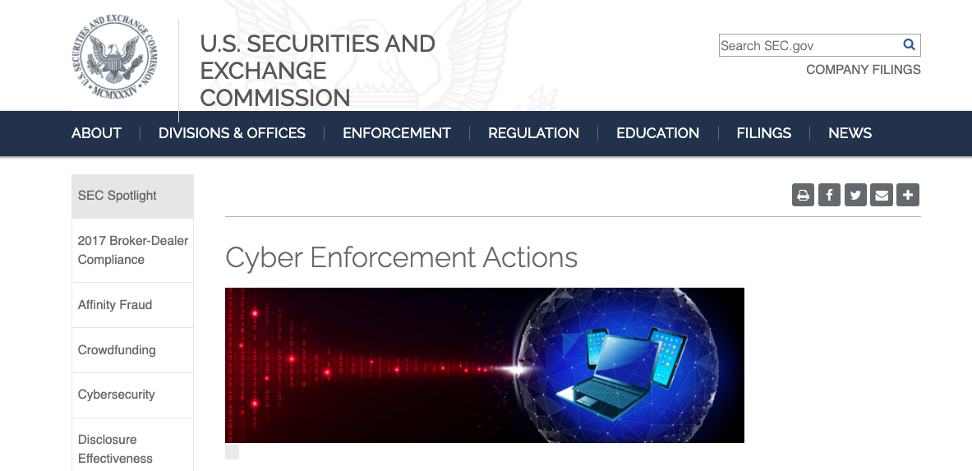
SEC
During the 1990s, the SEC worked with Congress to pass anti-fraud laws to discourage cybercrime. In 2000, the SEC moved past simple anti-fraud laws by adopting the regulatory statute Regulation S-P.
https://www.sec.gov

Slide 35
Industry-Specific Laws
Different industries have different laws:
The Family Educational Rights and Privacy Act (FERPA)
Gramm-Leach- Bliley Act (GLBA)
Federal Information Security Management Act of 2002 (FISMA)
Health Insurance Portability and Accountability Act (HIPAA)
Protects the privacy of student education records. Parents or eligible students have the right to request records be corrected if they believe them to be misleading or inaccurate.
Requires financial institutions that provide consumers financial products and services to provide an explanation of their information-sharing practices to safeguard sensitive data.
Requires the protection of government data, operations, and assets against natural or man-made threats.
Regulates the flow of healthcare information and states how personally identifiable information (PII) should be protected from misuse and theft within the healthcare industry.

Slide 36
Regulations are detailed instructions on how laws should be enforced.

Slide 37

Sometimes referred to as administrative laws, regulations are backed by the force of law and their application is mandatory.
Legislative bodies pass laws and government agencies create regulations that implement the laws.
Notes:
shutterstock_650042977

Slide 38
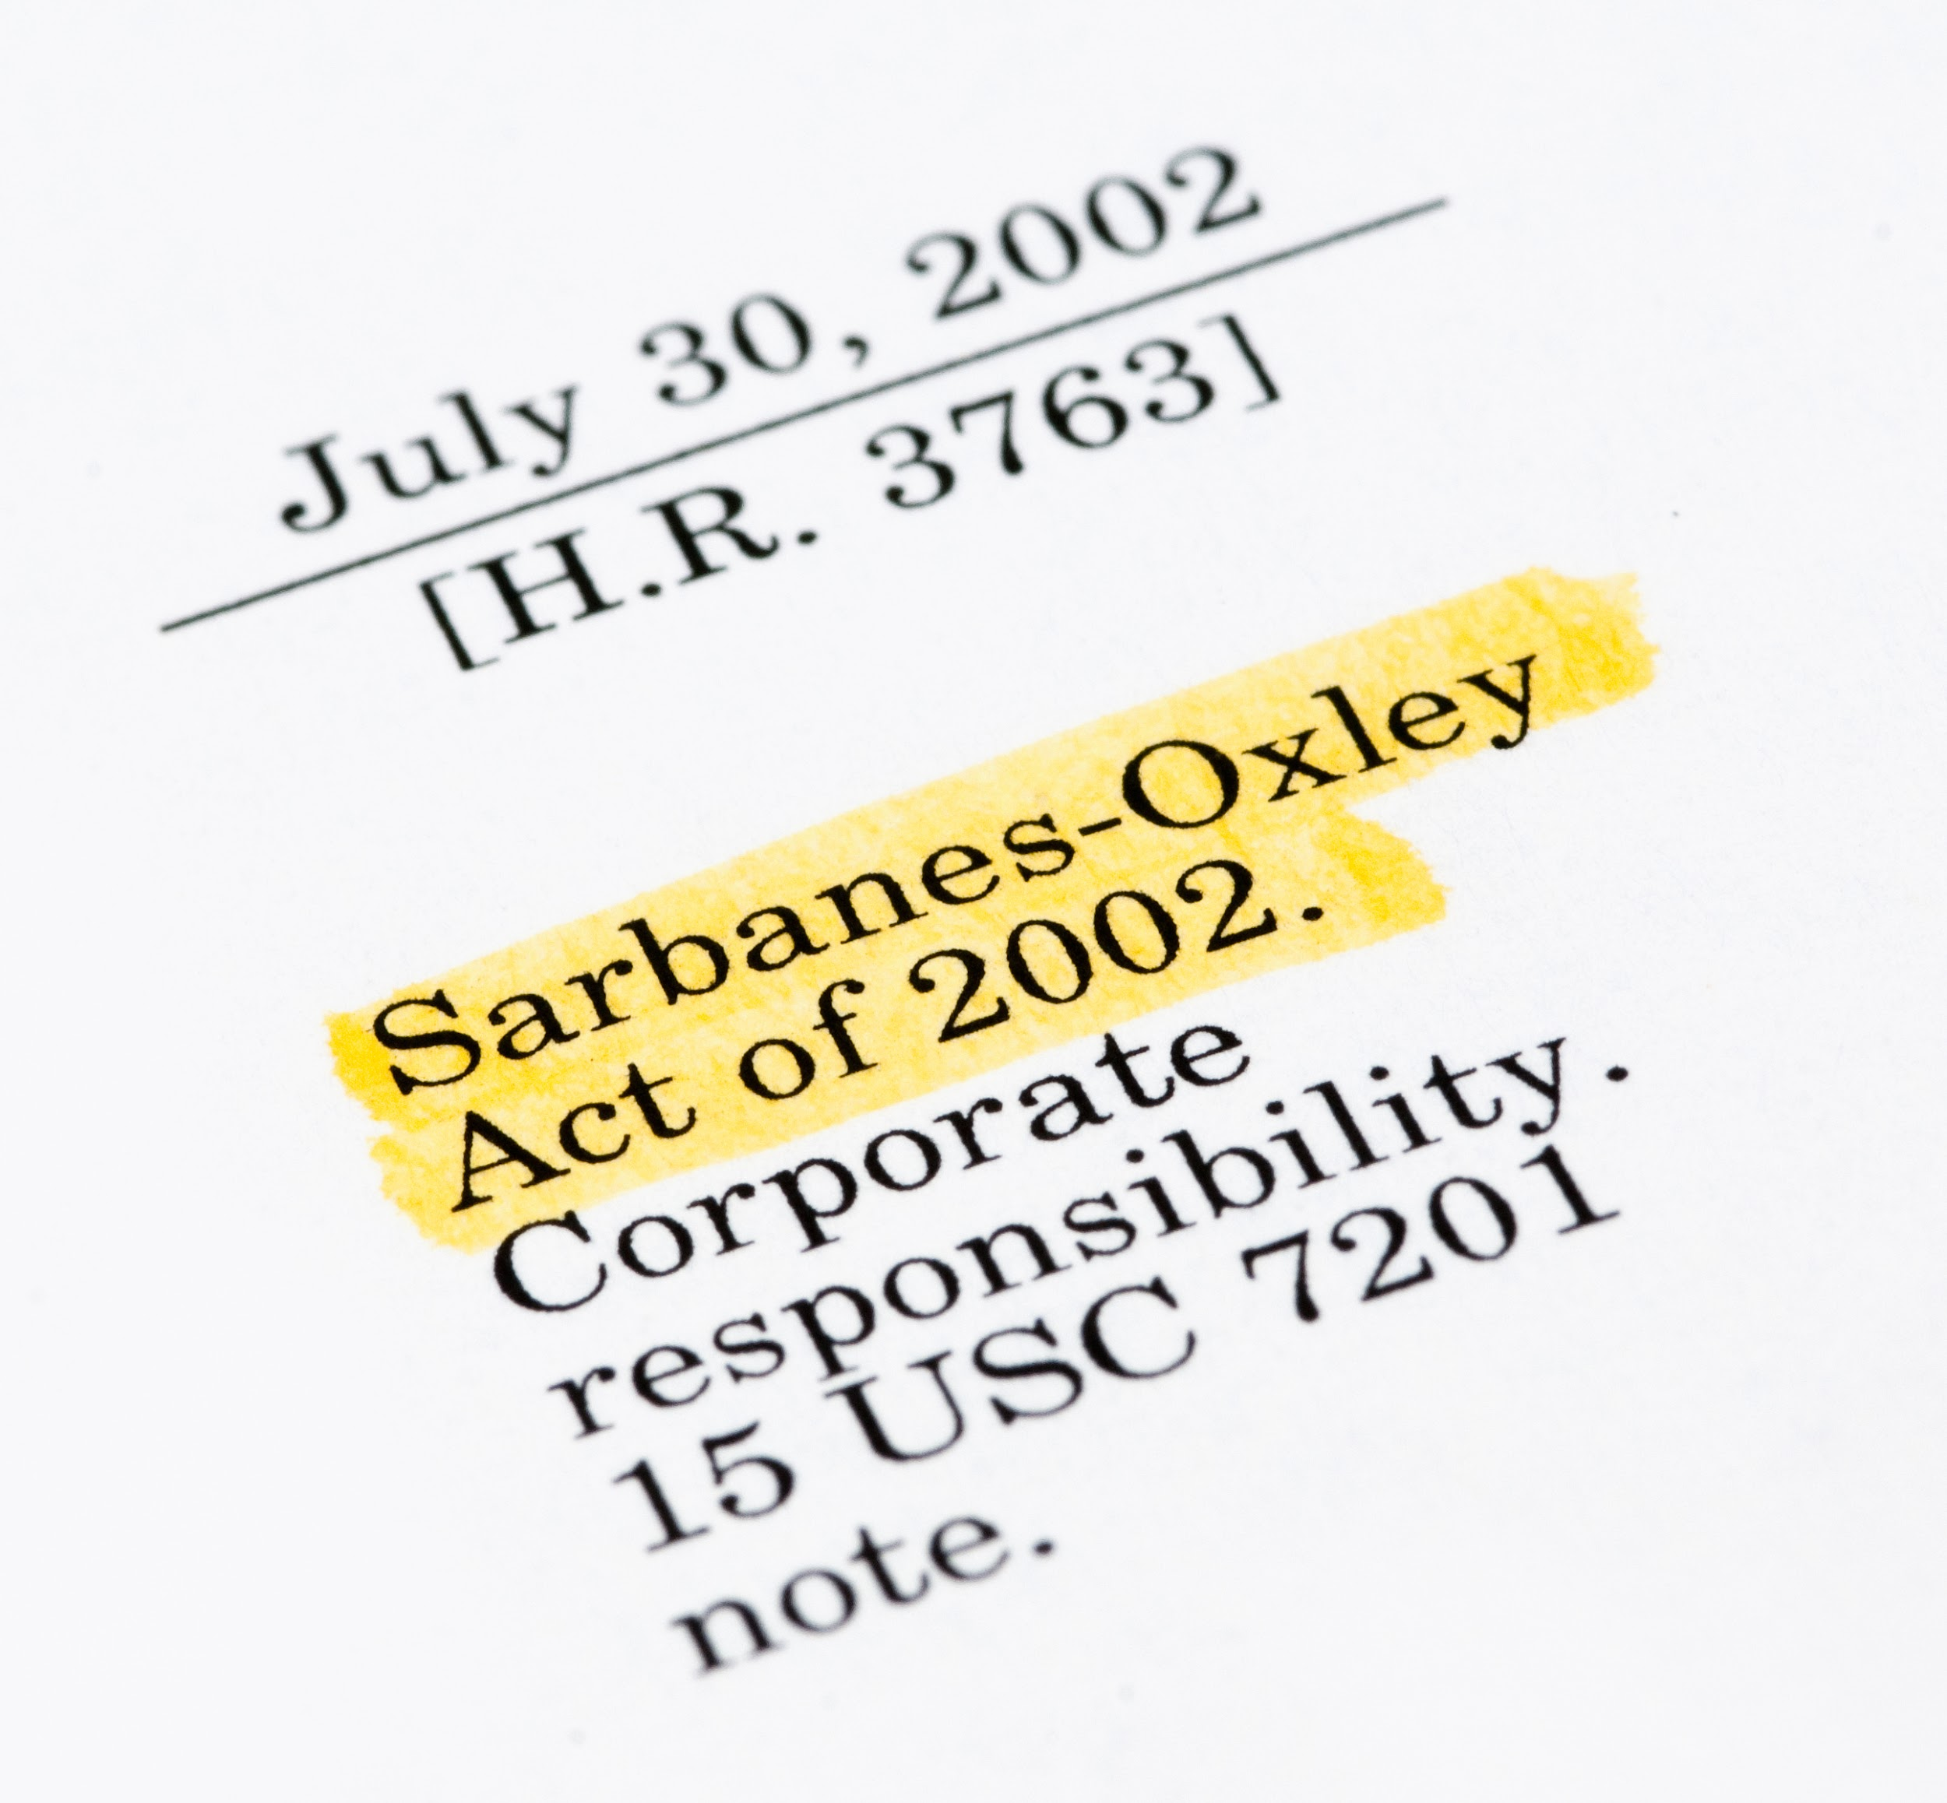
Regulations
Some of the more popular regulations within information security include:
Sarbanes–Oxley Act of 2002 (SOX), a result of the Enron and WorldCom scandal, holds corporate officers, board members, and executive management liable if the organization they represent is not compliant with the law.
Noncompliance includes negligence and failure to implement any recommended precautions.
Due diligence and due care must be demonstrated at all times.
Notes:
shutterstock_155277629

Slide 39

Regulations
Some of the more popular regulations within information security include:
General Data Protection Regulation (GDPR) protects the private data of all citizens of the European Union (EU) and European Economic Area (EEA).
Requires organizations that process data belonging to EU citizens protect the data sufficiently.
GDPR regulations apply to organizations based in the EU, as well as those based elsewhere that process data belonging to EU citizens.
Notes:
shutterstock_1100645201

Slide 40
Standards are published specifications used to establish a common language and technical criteria across an organization or industry.

Slide 41

Standards Example
Merchants that process financial transactions are contractually required to comply with the Payment Card Industry Data Security Standard (PCI-DSS) to guarantee that their customers’ data remains confidential.
If a company suffers a breach that results in the disclosure of customer PII, they may have to pay large fines and face other legal penalties.

Slide 42
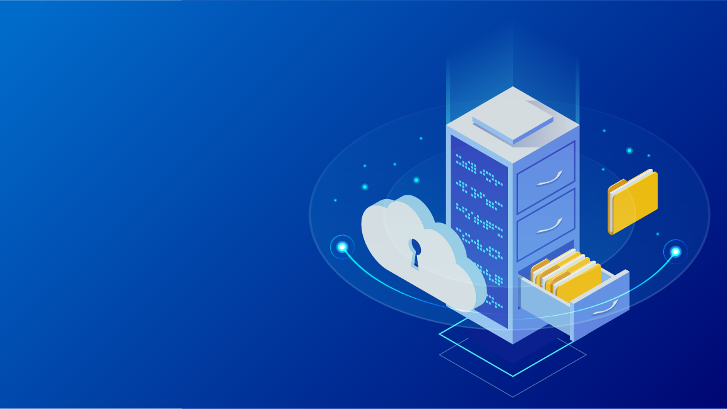
Risk Management Frameworks
Properly implemented information security frameworks allow security professionals to intelligently manage cyber risks within their organizations.
Frameworks consist of various documents clearly defining adopted procedure, policies, and processes, which an organization must follow.
Having an information security framework reduces an organization’s risk and exposure to vulnerabilities.
Notes:
shutterstock_1105902953

Slide 43

Risk Management Frameworks
Establishing a solid information security framework provides many advantages:
01
02
03
Instills confidence in your industry.
Establishes a strong reputation with business partners.
Provides a reputable relationship with customers.
Notes:
shutterstock_1105902953

Slide 44
The Risk Management Framework (RMF) is a set of standards developed by the National Institute of Standards and Technology (NIST).

Slide 45

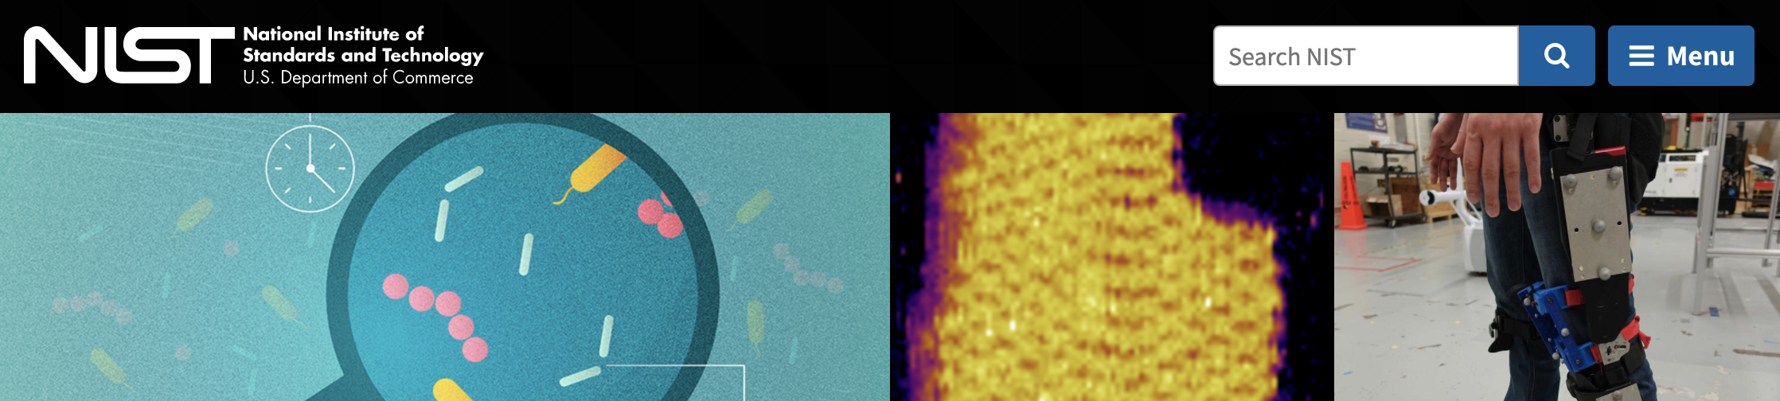
Risk Management Frameworks
Special Publication 800-37r2
Special Publication 800-53
“Risk Management Framework for Information Systems and Organizations,” describes the formal RMF certification and accreditation process.
“Security and Privacy Controls for Federal Information Systems and Organizations,” describes a structured process for an organization to select system security controls and integrate them as part of an organizational risk management program.
(nist.gov)

Slide 46

National Institute of Standards and Technology (NIST)
NIST is a federal agency within the United States Department of Commerce.
NIST’s mission is to develop and promote standards, measurements, and technology that enhances productivity, facilitates trade, and improves quality of life.
Since 2014, the NIST Cybersecurity Framework has provided guidance for critical infrastructure so organizations can better manage and reduce cybersecurity risks.

Slide 47
NIST Cybersecurity Framework
The NIST Cybersecurity framework is made of categories, subcategories, and informative resources.
Functions | Categories | Subcategories | Informative References
Identify
Protect
Detect
Respond
Recover

Slide 48
Let’s take a look at how an organization would implement the NIST Risk Management Framework.

Slide 49

NIST RMF Scenario
An organization has just recovered from an attack. They must now consider what can they can do to mitigate this attack from happening again.
Solution
The organization decides to incorporate “lessons learned” as part of their incident response. They will adopt and incorporate a security control from the Improvements category of the NIST RMF with a subcategory of RS.IM-1.
Function | Category | Subcategory | CCS CSC | COBIT 5 | ISA 62443-2-1: 2009 | ISA 62443-3-3: 2013 | ISO/IEC 27001:2013 | NIST SP 800-53 REV. 4
RS | IM | IM-1 |  | BA101.13 | 4.3.4.5.10, 4.4.3.4 |  | A.16.1.6 | CP-2, IR-4, IR-8
Appendix A - Framework Core Informative References
https://www.nist.gov
Notes:
shutterstock_287479460

Slide 50
NIST RMF Scenario
Improvements (RS.IM): Organizational response activities are improved by incorporating lessons learned from current and previous detection and respond activities.
RS.IM-1: Response plans incorporate lessons learned.
Function | Category | Subcategory | Informative Resources
Respond | Improvements (RS.IM): Organizational response activities are improved by incorporating lessons learned from current and previous detection/ response activities. | RS.IM-1: Response plans incorporate lessons learned | COBIT 5 BAI01.13 ISA 62443-2-1:2009 4.3.4.5.10, 4.4.3.4 ISO/IEC 27001:2013 A.16.1.6, Clause 10 NIST SP 800-53 Rev. 4 CP-2, IR-4, IR-8
 |  | RS.IM-2: Response strategies are updated | COBIT 5 BAI01.13, DSS04.08 ISO/IEC 27001:2013 A.16.1.6, Clause 10 NIST SP 800-53 Rev. 4 CP-2, IR-4, IR-8
(nist.gov)

Slide 51
An RMF is a set of documents that define best practices.
An organization may voluntarily follow these to efficiently manage its cybersecurity risks.
‹#›

Slide 52

Setup for Next Activity
In the next activity, you will play the role of a security consultant for a new online auction company, E-Auctions.com.
You are tasked with determining E-Auctions.com’s security posture before the business is launched.
You’ll accomplish this by conducting an interview with the CEO of E-Auctions.com. Your instructor will play the role of CEO.
As a class, you will each develop one question about E-Auctions.com's security posture and take turns interviewing the CEO.
Notes:
shutterstock_1177099138

Slide 53
Setup for Next Activity
You will be assigned a number between 1 and 22.
This number will correspond to a NIST category.
You will develop a question relevant to the NIST category you are assigned.
NIST documentation is provided so you can learn about your category and subcategories.
1 | Asset Management (ID.AM)
2 | Business Environment (ID.BE)
3 | Governance (ID.GV)
4 | Risk Assessment (ID.RA)
5 | Risk Management Strategy (ID.RM)
6 | Access Control (PR.AC)
7 | Awareness and Training (PR.AT)
8 | Data Security (PR.DS)
9 | Information Protection Processes and Procedures (PR.IP)
10 | Maintenance (PR.MA)
11 | Protective Technology (PR.PT)
12 | Anomalies and Events (DE.AE)
13 | Security Continuous Monitoring (DE.CM)
14 | Detection Processes (DE.DP)
15 | Response Planning (RS.RP)
16 | Communications (RS.CO)
17 | Analysis (RS.AN)
18 | Mitigation (RS.MI)
19 | Improvements (RS.IM)
20 | Recovery Planning (RC.RP)
21 | Improvements (RC.IM)
22 | Communications (RC.CO)

Slide 54
Activity: CEO Interviews
In this activity, you will formulate a question and pose it to the CEO of E-Auctions.com.
10 Minutes

Slide 55
Everyone Do: CEO Interview
Take turns asking your questions.
25 Mins
‹#›

Slide 56
‹#›

Slide 57
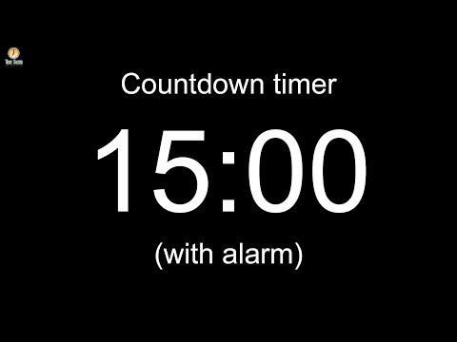
‹#›
Notes:
Image source: AdobeStock_56885471

Slide 58
Business Continuity Planning and Disaster Recovery (BCP and DR)

Slide 59

All of the machinery of governance and compliance can’t guarantee that an organization will not experience a breach.
Businesses must still have contingency plans to prepare for the worst.
Notes:
shutterstock_217638118

Slide 60
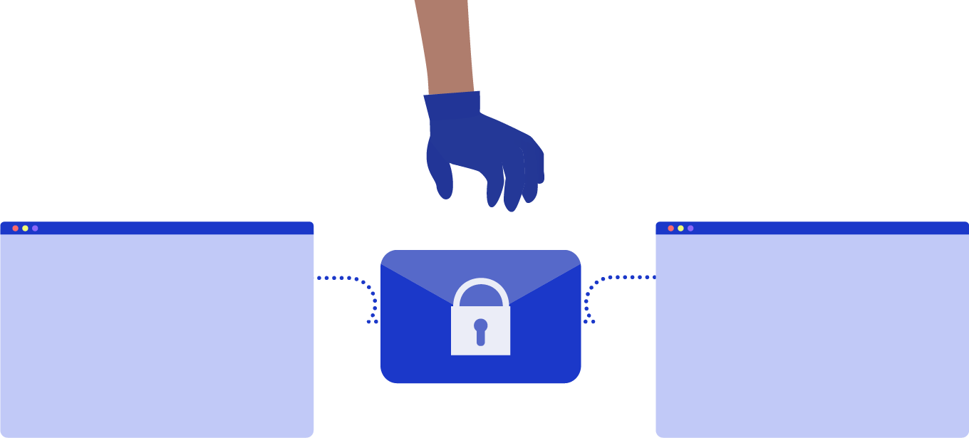
Contingency Planning for Business Continuity
A breach can have one of two results:
01
Mild or moderate breach:
02
Serious or catastrophic breach:
The business has been impacted, but can still handle day-to-day operations at greater cost.
The business has been impacted so severely that it cannot operate. Instead, they must use their resources to contain the incident, recover from the disaster, and eventually return to operations.
Notes:
shutterstock_1276712677

Slide 61

Security Concerns vs. Business Concerns
BCP and DR planning focus on contingency plans in the event of a disruption or disaster, and ensure that the business can resume daily operations.
Notes:
shutterstock_1421998877

Slide 62
What are some possible disruptions or disasters?

Slide 63

Contingency Planning for Business Continuity
Cyberattacks
Human errors
Environmental disasters
Notes:
Image sources: shutterstock_411741793, shutterstock_185621111, shutterstock_511910884

Slide 64
Business Continuity Planning vs. Disaster Recovery
It is important to note the differences between BCP and DR.
Business Continuity Planning
Disaster Recovery
Focuses on processes and procedures to ensure business critical functions continue during and after a disaster.
Focuses on the specific steps an organization must take to resume work after a disaster.

Slide 65
Business Continuity Planning and Disaster Recovery
BCP and DR both begin with a contingency planning policy and business impact analysis.
BCP and DR both begin with a contingency planning policy and business impact analysis.
Strategies for high-impact loss should consider high availability and redundancy options. For example, fully redundant load balanced systems at alternate sites, data mirroring, and offsite database replication.
High-availability options are normally expensive to set up, operate, and maintain and should be considered only for high-impact information systems categorized with a high-availability security objective.
Lower-impact information systems may be able to use less expensive contingency options and tolerate longer downtimes for recovery or restoration of data.

Slide 66
NIST Impact Levels
The following descriptions of impact levels originally appear in NIST’s Contingency Planning Guide for Federal Information Systems.
Low
Moderate
High
The loss of confidentiality, integrity or availability could be expected to have a limited adverse effect on organizational operations, assets and individuals.
The loss of confidentiality, integrity or availability could be expected to have a serious adverse effect on organizational operations, assets and individuals.
The loss of confidentiality, integrity or availability could be expected to have a severe or catastrophic adverse effect on organizational operations, assets and individuals.

Slide 67
Contingency planning results in a contingency policy statement, which establishes the organization’s framework and responsibilities for maintaining confidentiality, integrity, and availability of data.

Slide 68
Contingency Planning
A contingency policy statement includes:
Responsibilities of an emergency response team
Resource requirements
Training requirements
Schedule for plan maintenance

Slide 69
Business Impact Analysis (BIA) and Risk Assessment
A critical step in BCP and DR planning is BIA and risk assessment. Goals include:
Identify key processes and functions of the business.
Establish a detailed list of requirements for business recovery.
Determine the resource requirements needed to resume key processes.
Evaluate impact on daily operations.
Develop priorities and classifications of business processes and functions.
Develop recovery time requirements.
Determine financial, operations, and legal impact of disruptions.

Slide 70
BIA Metrics
The results of the BIA impacts how the DR plan develops. In particular, it informs the following metrics:
Recovery point objective (RPO):
Maximum tolerable downtime (MTD):
Amount of data that a business can afford to lose or recover (given the most recent backup copy of the data) after a disruption or system outage.
For example, if a company performs weekly backups, they can tolerate or recover from a week’s loss of data.
Total amount of time a system can afford to be unavailable for users and the business.
Recovery time objective (RTO): Maximum tolerable amount of time needed to bring all critical systems back online after a disaster occurs.
Work recovery time (WRT): Time available to get the systems working again. WRT is the remainder of the MTD after the RTO. If MTD is four days and RTO is one day, WRT is three days.

Slide 71
BIA Metrics
MTD
RPO
RTO
WRT
Time
Stage 1 Business as usual
Stage 2 Disaster occurs
Stage 3 Recovery
Stage 4 Resume production
Source

Slide 72

Alternate Sites
One last consideration for disaster recovery is the use of alternate sites to house critical data technology functions. While disasters are rare, they may require that operations move to an alternate site.
A hot site is ready at all times.
It has equipment loaded with currently available data and can immediately continue operations. It is costly, but important for mission-critical data.
A cold site has very little existing infrastructure.
It is not typically used until after a disaster occurs, so there must be a strategy for setting it up quickly when the time comes.
A warm site is in-between.
For example, servers, hardware, software, and other equipment might be set up but not loaded with the latest data.
Notes:
Image source: shutterstock_557774158

Slide 73
Activity: Disaster Recovery Planning
In this activity, you will continue to work in groups to create a high-level disaster recovery plan for GeldCorp.
10 Minutes

